Slide 1
Advanced Design Scripting & Parametrics
Introduction, Grids

Slide 2
Class motivations
“Computational thinking”
Learn the constructs of computing, programming, and AI
Problems into systems, sequence & partition development, etc.
Computation geometry & geometric algorithms
Skills
advanced Rhino, what’s going on “under the hood”, how to control it
Python – a very easy & powerful programming language an ecosystem of libraries, APIs
How to hack
And, then there’s AI…

Slide 3
Class schedule

Slide 4
Setting up the AI coding environment
Install
visual studio code https://code.visualstudio.com/
git https://git-scm.com/
github desktop https://desktop.github.com/download/
Github registration
Access Copilot from VS Code
Setting up the RhinoPython “integration”

Slide 5
Today – key concepts
Setting up the development & AI environment
Importing necessary libraries
All things “Grids”
Variables, including returned Rhino IDs from creating objects
rs.Add functions
rsGetX functions
range() and np.arange()
looping
Short homework

Slide 6
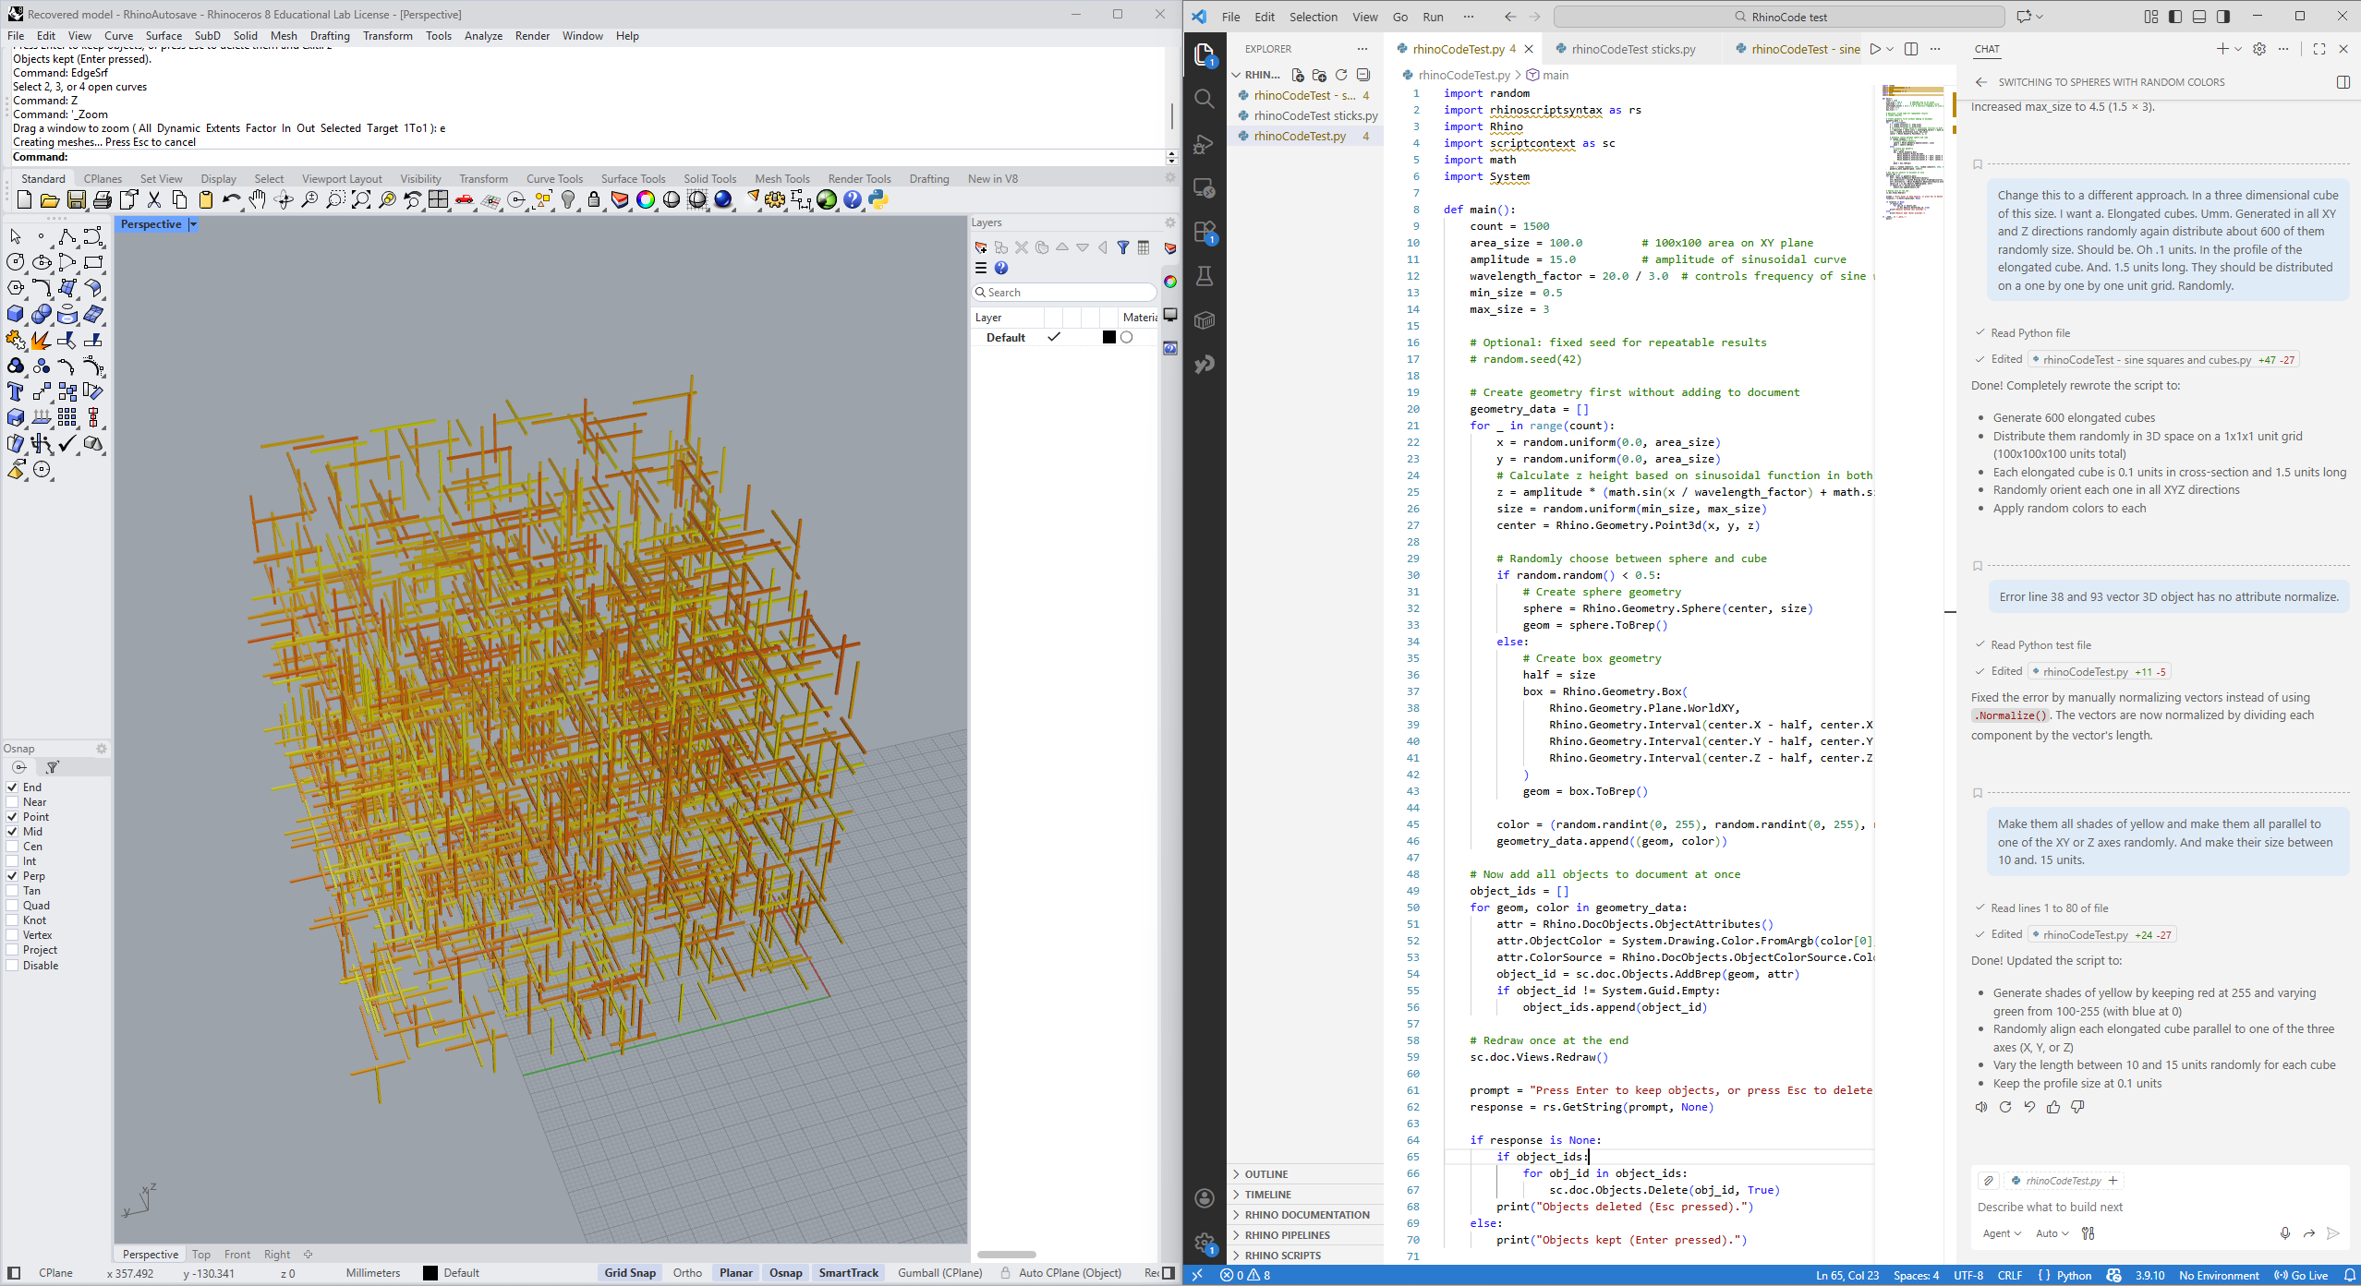
Vibe coding new!

Slide 7
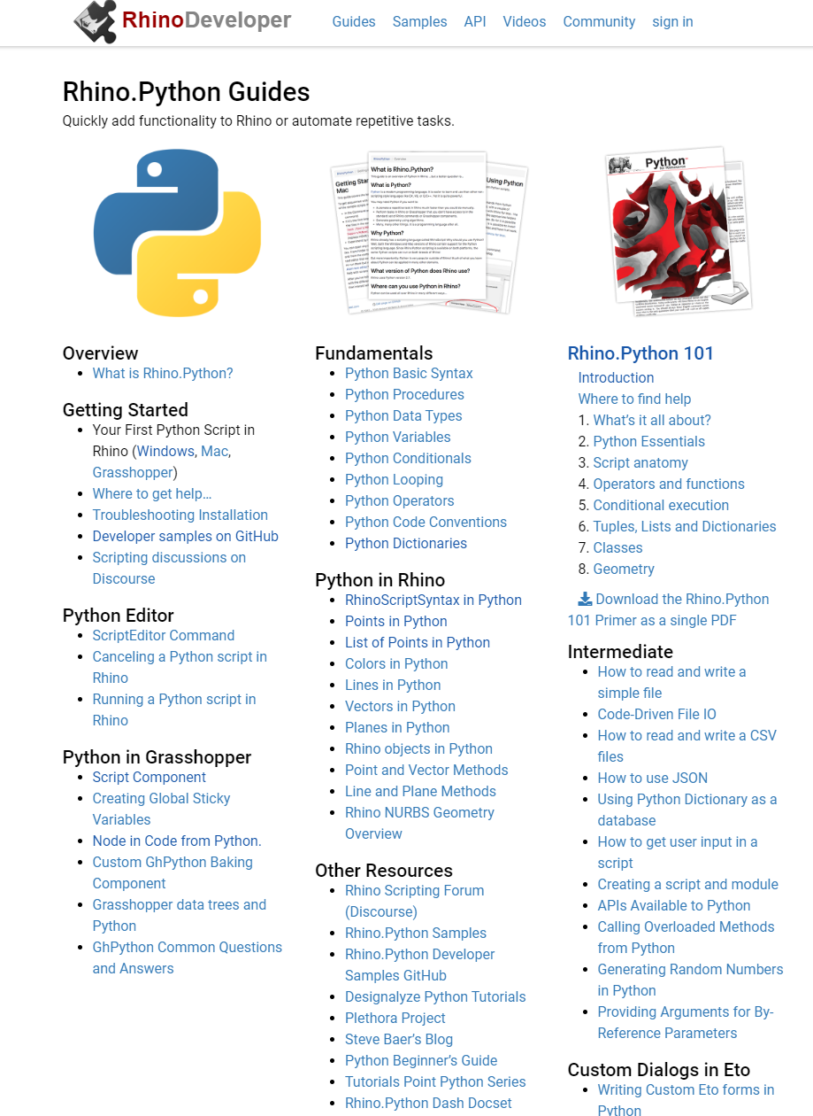
https://developer.rhino3d.com/guides/rhinopython/

Slide 8
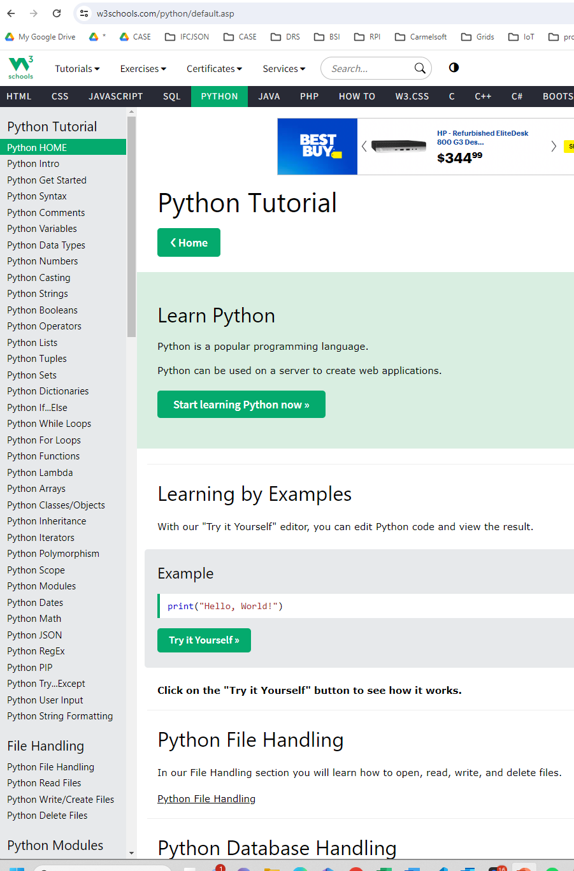
https://www.w3schools.com/python/default.asp

Slide 9
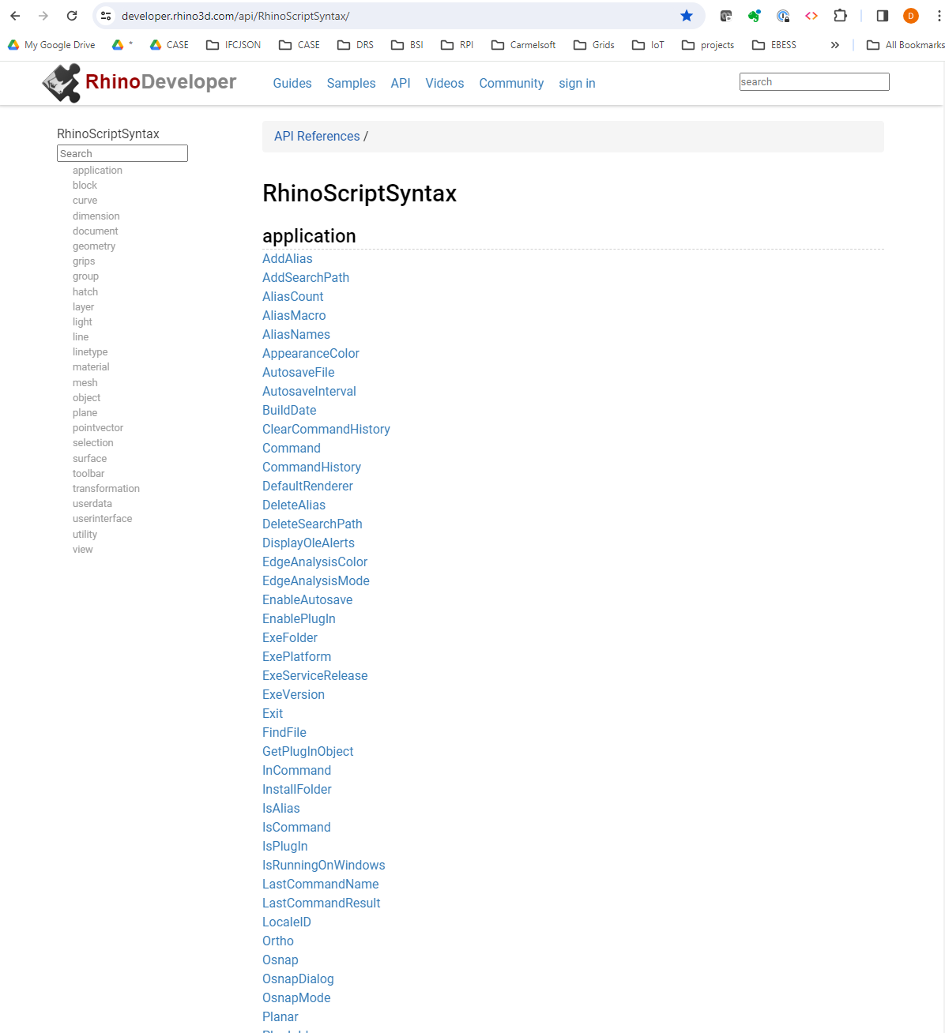
https://developer.rhino3d.com/api/RhinoScriptSyntax/

Slide 10
Setting up the AI coding environment
Install
visual studio code https://code.visualstudio.com/
git https://git-scm.com/
github desktop https://desktop.github.com/download/
Github registration, email me your github ID
Github course repository: https://github.com/Drshelden/DP2
Access Copilot from VS Code
Setting up the RhinoPython “integration”

Slide 11
RhinoPython integration: Create an Alias
Tools>Options>Aliases, Import “MakeDPAlias.txt”
Run DP2setup.bat
In Rhino: “Toolbar”, File->Open, “Design Programming 2.rui”
Open the folder “"C:\_LOCAL\DP2\RhinoCode“ in VS Code
In Rhino:
Test the DP alias and the Design Programming button.
Save "C:\_LOCAL\DP2\RhinoCode\WorkingCode.py“ and DP again

Slide 12
Basic importing of libraries
Always start your program with this:
import rhinoscriptsyntax as rs
import scriptcontext as sc
import System
import System.Collections.Generic
import Rhino
import random
import math

Slide 13
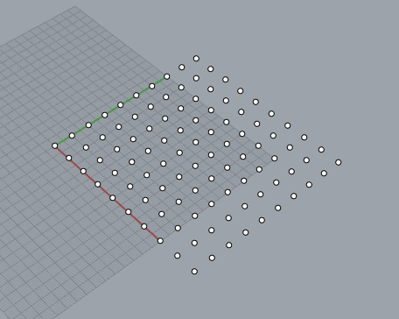
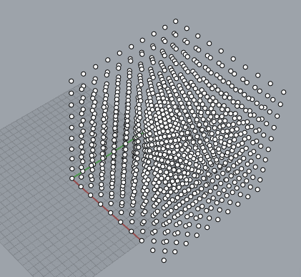
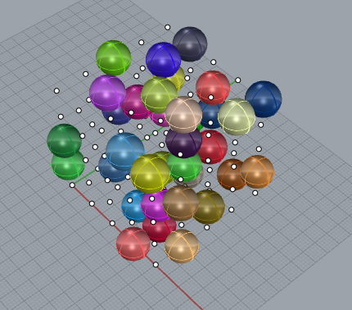
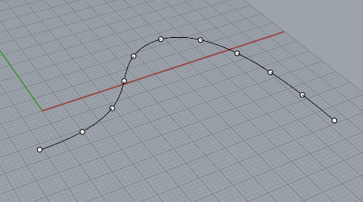
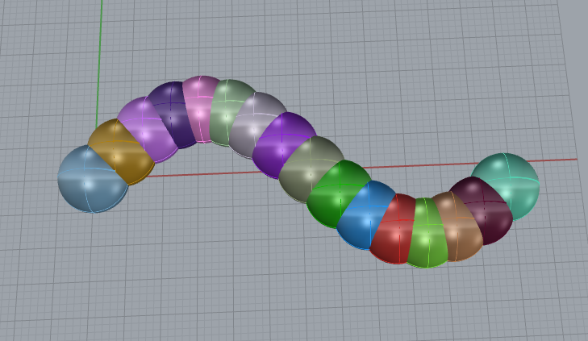
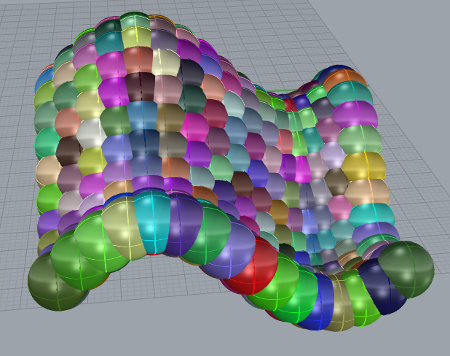
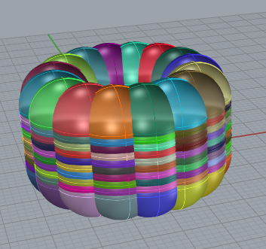
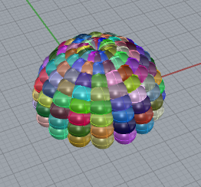
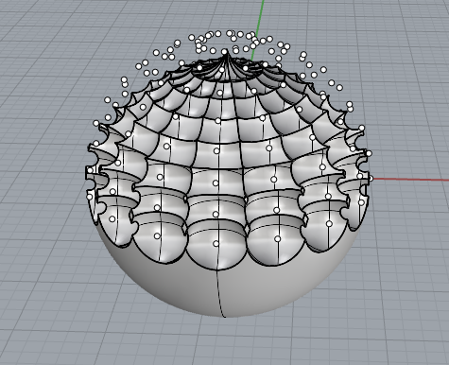
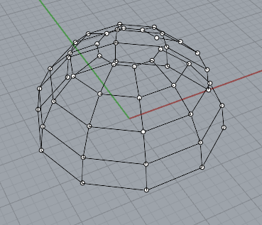
2D Grid
3D Grid
3D Grid with Random Spheres
along curve
Sine Function 2D
Sine Function 3D
cylindrical coordinates
spherical coordinates
spherical coordinates with boolean
spherical coordinates with grid

Slide 14
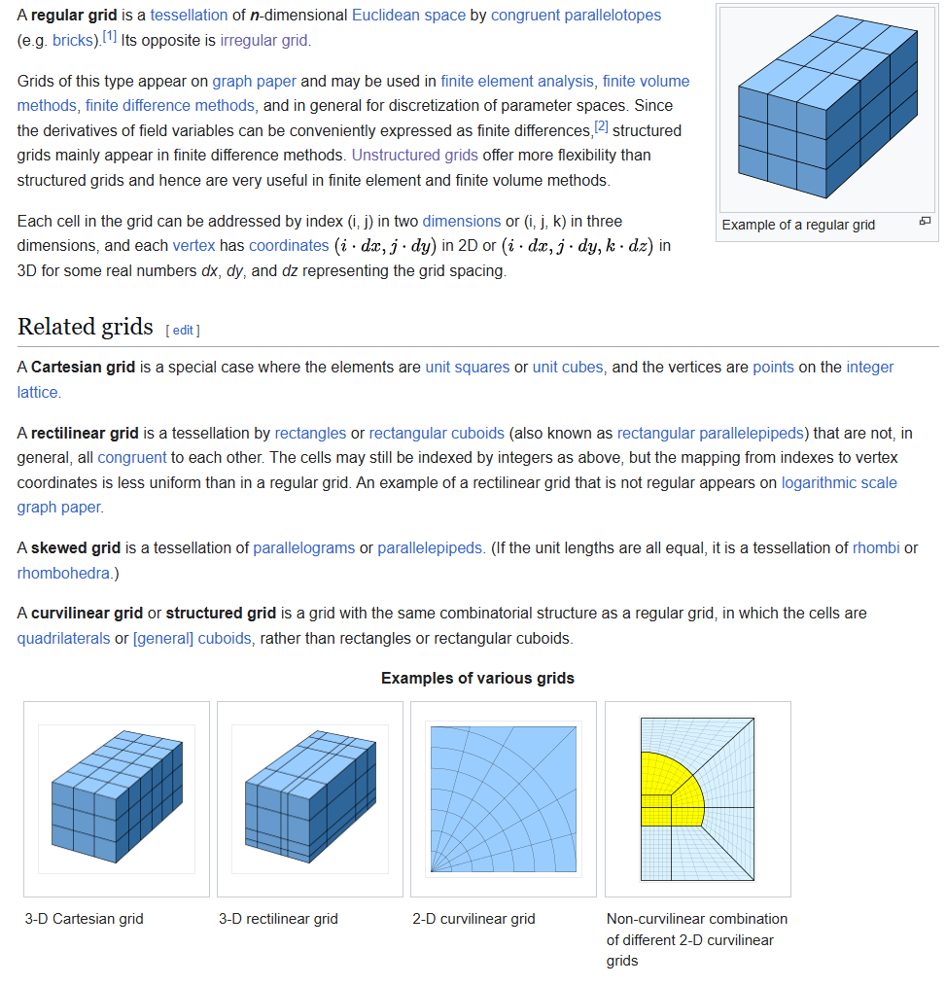
What’s a “grid”?

Slide 15
Starter file for our class: Class01.00 Starter.py
#! python3
"""Testing pip install specific packages"""
# r: numpy
import rhinoscriptsyntax as rs
import scriptcontext as sc
import System
import System.Collections.Generic
import Rhino
import random
import math
import numpy as np
xCount = 5
yCount = 5
zCount = 5
xScale = 10
yScale = 10
zScale = 10
rSphere = 5
# Your Code Here!
# done!
#some instructions to python
# imports a namespace and calls it by the nickname “rs”
#import some libraries of code – just like this code
#define some variables and set their initial values
#comments – ignored by Python but useful for humans

Slide 16
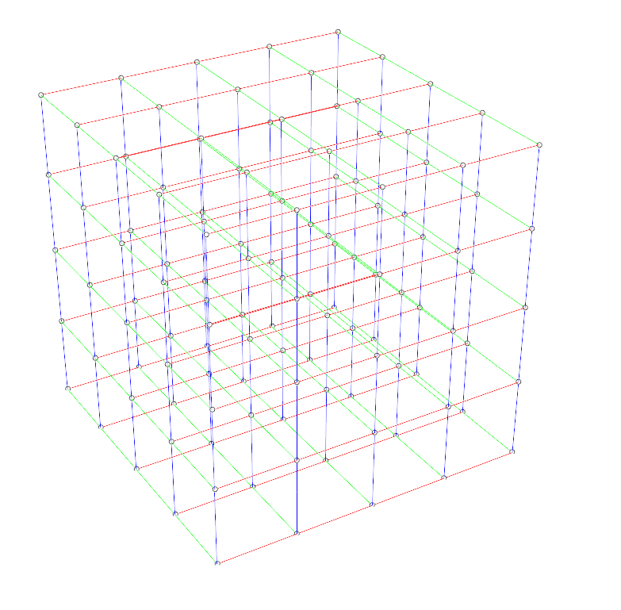
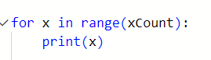
Starter file for our class: Class01.00 Starter.py
#! python3
"""Testing pip install specific packages"""
# r: numpy
import rhinoscriptsyntax as rs
import scriptcontext as sc
import System
import System.Collections.Generic
import Rhino
import random
import math
import numpy as np
xCount = 5
yCount = 5
zCount = 5
xScale = 10
yScale = 10
zScale = 10
rSphere = 5
# Your Code Here!
# done!
ySize
yCount
ySize
yCount
xSize
xCount

Slide 17
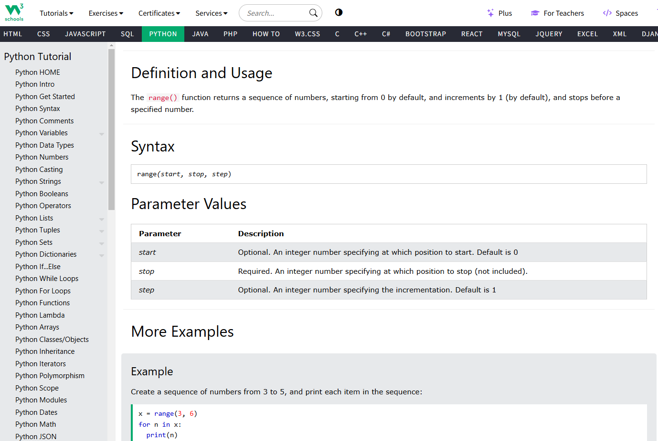
range() # python function
A predefined function in the python base language library:
Given an integer stop
Returns an array of integers
[0, 1, … stop – 1]
Some options:
range(stop) -> [0, …, stop – 1]
range(start, stop) -> [start, …, stop -1]
range(start, stop, step) ->
[start, start + step, start + 2*step, …, stop -1]
x = range(5) # creates an array [0,…,4]
for n in range(x): #makes an arbitrary variable n
for each value in x assigns this
value to n and runs the nested code
print(n)

Slide 18
#! python3
"""Testing pip install specific packages"""
# r: numpy
import rhinoscriptsyntax as rs
import scriptcontext as sc
import System
import System.Collections.Generic
import Rhino
import random
import math
import numpy as np
xCount = 10
yCount = 10
zCount = 10
xScale = 10
yScale = 10
zScale = 10
rSphere = 5
# Print out the coordinates of each point
for x in range(xCount):
for y in range(yCount):
pointId = rs.AddPoint((x * xScale, y * yScale,0))
print(x, y, pointId)
# done!
Class01.01 2D Grid.py

Slide 19
#! python3
"""Testing pip install specific packages"""
# r: numpy
import rhinoscriptsyntax as rs
import scriptcontext as sc
import System
import System.Collections.Generic
import Rhino
import random
import math
import numpy as np
xCount = 10
yCount = 10
zCount = 10
xScale = 10
yScale = 10
zScale = 10
rSphere = 5
# Print out the coordinates of each point
for x in range(xCount):
for y in range(yCount):
for z in range(zCount):
pointId = rs.AddPoint((x * xScale, y * yScale,z * zScale))
print(x, y, pointId)
# done!
Class01.02 3D Grid.py

Slide 20
#! python3
"""Testing pip install specific packages"""
# r: numpy
import rhinoscriptsyntax as rs
import scriptcontext as sc
import System
import System.Collections.Generic
import Rhino
import random
import math
import numpy as np
xCount = 5
yCount = 5
zCount = 5
xScale = 10
yScale = 10
zScale = 10
rSphere = 5
# Print out the coordinates of each point
for x in range(xCount):
for y in range(yCount):
for z in range(zCount):
pointId = rs.AddPoint((x * xScale, y * yScale,z * zScale))
print(x, y, pointId)
if (random.random() < 0.25):
sphereId= rs.AddSphere((x * xScale, y * yScale,z * zScale), rSphere)
rs.ObjectColor(sphereId, [int(random.random() * 255), int(random.random() * 255), \
int(random.random() * 255) ])
# done!
Class01.03 3D Grid with Random Spheres.py
random and random.random()

Slide 21
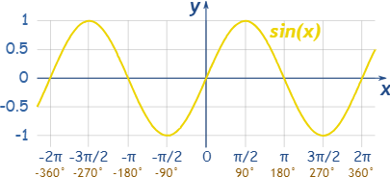
#! python3
"""Testing pip install specific packages"""
# r: numpy
import rhinoscriptsyntax as rs
import scriptcontext as sc
import System
import System.Collections.Generic
import Rhino
import random
import math
import numpy as np
xCount = 16
yCount = 5
zCount = 5
xScale = 10
yScale = 10
zScale = 10
rSphere = 5
listValues = np.arange(0, 2 * math.pi, 2 * math.pi / xCount)
print(listValues)
# Print out the coordinates of each point
for x in listValues: y = math.sin(x)
sphereId = rs.AddSphere( (x * xScale, y * yScale, 0), rSphere )
#print(sphereId)
rs.ObjectColor(sphereId, [int(random.random() * 255), int(random.random() * 255), \
int(random.random() * 255) ])
# done!
Class01.05 Sine Function 2D.py

Slide 22
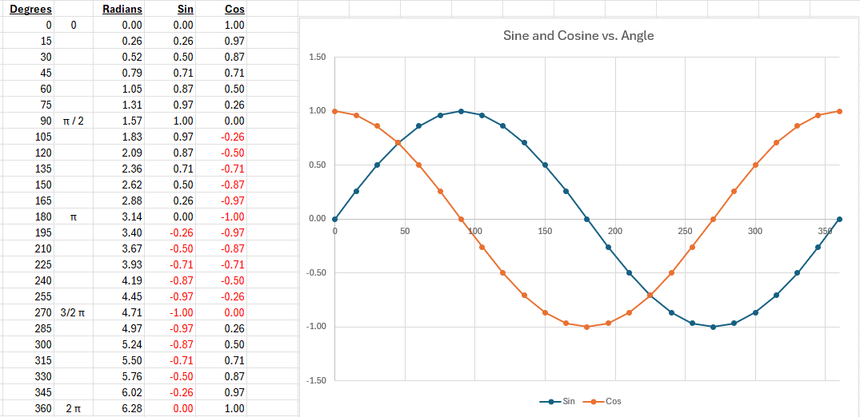
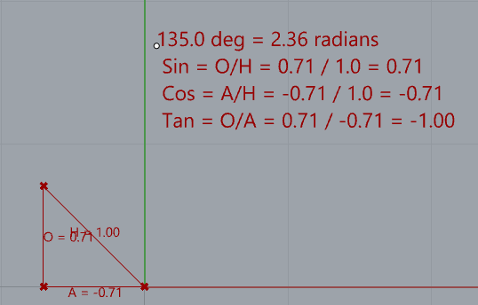
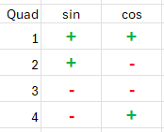
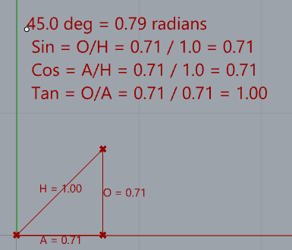
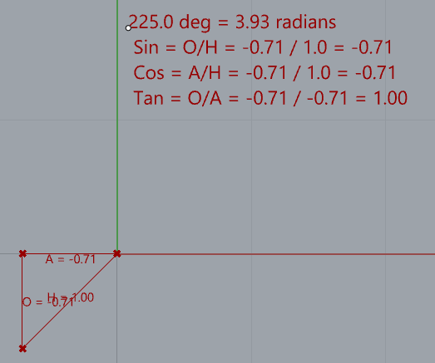
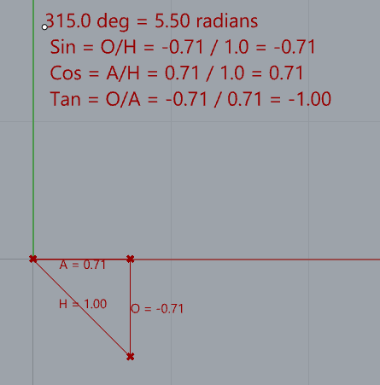
Sin =
Cos =
Tan =
O
H
A
H
O
A
Hypotenuse
Opposite
Adjacent

Slide 23
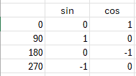
Trig to remember
Sin =
Cos =
Tan =
O
H
A
H
O
A
Sin =
Cos =
Tan =
1
√2
1
√2
1
1
∼ 0.707
Hypotenuse
H = √1∗1 + 1∗1 = √2
Opposite
O = 1
45deg
Π / 4 rad
Adjacent
A = 1
Sin =
Cos =
Tan =
1
2
√3
2
1
√3
H = 2
O = 1
30deg
Π / 6 rad
A = √3

Slide 24
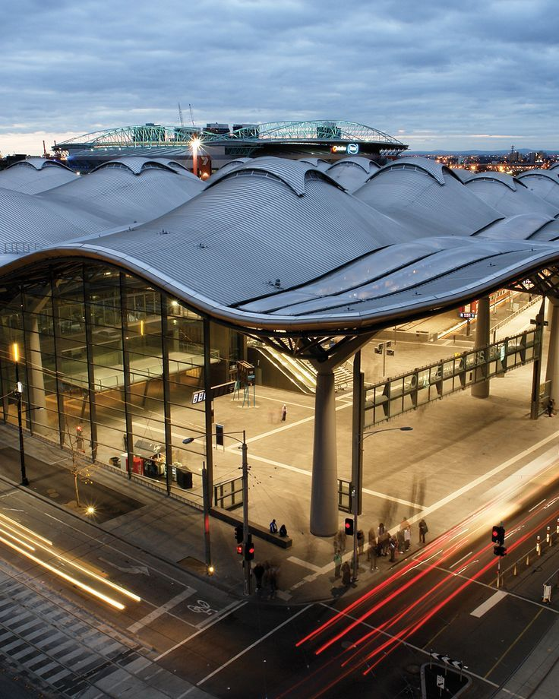
#! python3
"""Testing pip install specific packages"""
# r: numpy
import rhinoscriptsyntax as rs
import scriptcontext as sc
import System
import System.Collections.Generic
import Rhino
import random
import math
import numpy as np
xCount = 16
yCount = 5
zCount = 5
xScale = 10
yScale = 10
zScale = 10
rSphere = 5
listValues = np.arange(0, 2 * math.pi, 2 * math.pi / xCount)
print(listValues)
# Print out the coordinates of each point
for x in listValues:
for y in listValues:
z = math.sin(x) + math.sin(y)
sphereId = rs.AddSphere( (x * xScale, y * yScale, z * zScale), rSphere )
#print(sphereId)
rs.ObjectColor(sphereId, [int(random.random() * 255), int(random.random() * 255), \
int(random.random() * 255) ])
# done!
sine Function 2D.py

Slide 25
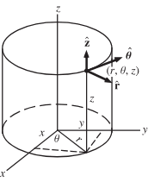
#! python3
"""Testing pip install specific packages"""
# r: numpy
import rhinoscriptsyntax as rs
import scriptcontext as sc
import System
import System.Collections.Generic
import Rhino
import random
import math
import numpy as np
xCount = 16
yCount = 5
zCount = 5
xScale = 10
yScale = 10
zScale = 10
rSphere = 5
thetaValues = np.arange(0, 2 * math.pi, 2 * math.pi / xCount) # 0 to 2PI in xCount steps
alphaValues = np.arange(0, 1.0, 1 / yCount) # 0 to PI / 2 in yCount steps
# Print out the coordinates of each point
for theta in thetaValues:
for alpha in alphaValues:
x = math.cos(theta)
y = math.sin(theta)
z = alpha
sphereId = rs.AddSphere( (x * xScale, y * yScale, z * zScale), rSphere )
#print(sphereId)
rs.ObjectColor(sphereId, [int(random.random() * 255), int(random.random() * 255), \
int(random.random() * 255) ])
# done!
Class01.06 cylindrical coordinates.py
alpha
theta
x = cos(theta)
y = sin(theta)

Slide 26
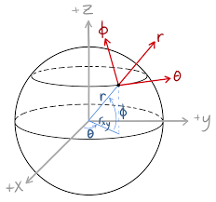
#! python3
"""Testing pip install specific packages"""
# r: numpy
import rhinoscriptsyntax as rs
import scriptcontext as sc
import System
import System.Collections.Generic
import Rhino
import random
import math
import numpy as np
xCount = 5
yCount = 5
zCount = 5
xScale = 10
yScale = 10
zScale = 10
rSphere = 2
thetaValues = np.arange(0, 2 * math.pi, 2 * math.pi /16) # 0 to 2PI in 16 steps
alphaValues = np.arange(0, math.pi / 2.0, math.pi / 16) # 0 to 1 in 0.1 steps
# Print out the coordinates of each point
for theta in thetaValues:
for alpha in alphaValues:
x = math.cos(theta) * math.cos(alpha)
y = math.sin(theta) * math.cos(alpha)
z = math.sin(alpha)
sphereId = rs.AddSphere( (x * xScale, y * yScale, z * zScale), rSphere )
#print(sphereId)
rs.ObjectColor(sphereId, [int(random.random() * 255), int(random.random() * 255), \
int(random.random() * 255) ])
# done!
Class01.07 spherical coordinates.py
alpha
theta
x = cos(theta) * cos(alpha)
y = sin(theta) * cos(alpha)
Z = sin(alpha)

Slide 27
#! python3
"""Testing pip install specific packages"""
# r: numpy
import rhinoscriptsyntax as rs
import scriptcontext as sc
import System
import System.Collections.Generic
import Rhino
import random
import math
import numpy as np
xScale = 10
yScale = 10
zScale = 10
rSphere = 5
thetaValues = np.arange(0, 2 * math.pi, 2 * math.pi / 16) # 0 to 2PI in 16 steps
alphaValues = np.arange(0, 1.0, 0.1) # 0 to 1 in 0.1 steps
# Print out the coordinates of each point
for theta in thetaValues:
for alpha in alphaValues:
x = math.cos(theta)
y = math.sin(theta)
z = alpha
sphereId = rs.AddSphere( (x * xScale, y * yScale, z * zScale), rSphere )
#print(sphereId)
rs.ObjectColor(sphereId, [int(random.random() * 255), int(random.random() * 255), \
int(random.random() * 255) ])
# done!
Class01.08 spherical coordinates with boolean.py

Slide 28
thetaValues = np.arange(0, 2 * math.pi, 2 * math.pi /xCount) # 0 to 2PI in xCount steps
alphaValues = np.arange(0, math.pi / 2.0, math.pi / yCount) # 0 to PI / 2 in yCount steps
pointIds = []
# Print out the coordinates of each point
i = 0
pointIds = [[0 for _ in range(xCount)] for _ in range(xCount)]
for theta in thetaValues:
j = 0
for alpha in alphaValues:
x = math.cos(theta) * math.cos(alpha)
y = math.sin(theta) * math.cos(alpha)
z = math.sin(alpha)
pointId = rs.AddPoint( (x * xScale, y * yScale, z * zScale) )
pointIds[i][j] = pointId
if (i > 0): rs.AddLine(pointIds[i-1][j], pointIds[i][j])
if (j > 0): rs.AddLine(pointIds[i][j-1], pointIds[i][j])
#sphereId = rs.AddSphere( (x * xScale, y * yScale, z * zScale), rSphere )
#print(sphereId)
#rs.ObjectColor(sphereId, [int(random.random() * 255), int(random.random() * 255), int(random.random() * 255) ])
j = j + 1
i = i + 1
# done!
Class01.09 spherical coordinates with grid.py

Slide 29
#! python3
import rhinoscriptsyntax as rs # this is the rhinoscript library
import scriptcontext as sc # configuration?
import System # standard base python
import System.Collections.Generic #collections specific library
import Rhino # Rhino
# Array points along a curve
crv_id = rs.GetObject("Select path curve")
if not crv_id: exit
count = rs.GetInteger("Number of items", 2, 2)
if not count: exit
points = rs.DivideCurve(crv_id, count)
for point in points: rs.AddPoint(point)
Class01.10 along curve.py
rs.GetObject(“prompt”)
rs.GetInteger(“prompt”)
...

Slide 30
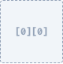
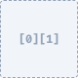
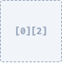
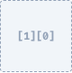
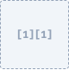
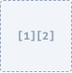
The Problem: Managing Data
When we create objects in a simple loop, the script "forgets" them immediately after creation.
To perform complex operations like connecting points with lines, we need a way to store and retrieve these Object IDs based on their grid position [x][y].

Slide 31
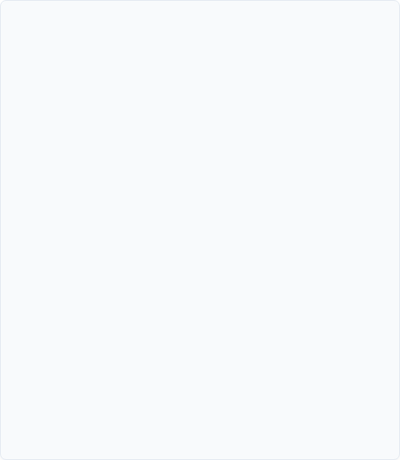
Concept: Pre-allocating the Matrix
Step 1: Initialization
# Creating an empty "Map" first
grid = [
[None, None, None], # Row 0
[None, None, None], # Row 1
[None, None, None], # Row 2
[None, None, None] # Row 3
]
# OR
grid = []
for x in range(xCount):
row = []
for y in range(yCount):
row.append([])
grid.append(row)
Instead of appending items dynamically, we first Initialize a grid of empty containers.
This "Pre-allocation" phase sets up the structure of our data before any geometry exists. It's like building the shelves before buying the books.

Slide 32

Initialization Code
1_init_matrix.py
xCount = 5 yCount = 5 # Main Container
sphere_matrix = [] # 1. Pre-allocation Loop
for x in range(xCount):
# Create a row of empty slots
empty_row = [None] * yCount
# Add the empty row to the main matrix sphere_matrix.append(empty_row)
Here, we use a nested loop to create a list of lists filled with None.
This explicitly defines the dimensions of our data structure before we start doing the heavy work of creating geometry.

Slide 33
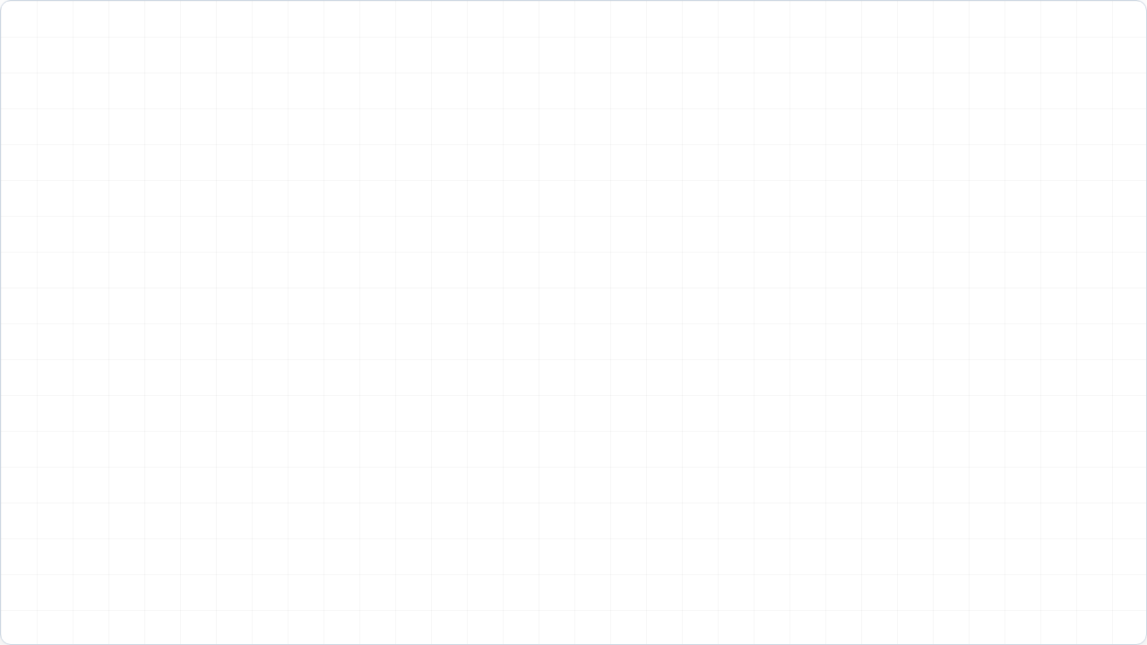
2_populate_matrix.py
Step 2: Population
# 2. Population Loop
for x in range(xCount):
for y in range(yCount):
# Create Geometry
pt = (x*10, y*10, 0)
s_id = rs.AddSphere(pt, 2)
# Assign to specific slot
# We replace 'None' with the ID sphere_matrix[x][y] = s_id
Now we iterate through our dimensions again.
This time, we create the actual geometry and assign the resulting Object ID to the specific slot sphere_matrix[x][y] we prepared earlier.

Slide 34
Step 3: Utilization (Connectivity)
3_connect_matrix.py
# 3. Utilization Loop (Connectivity)
for x in range(xCount):
for y in range(yCount):
current_id = sphere_matrix[x][y]
# Connect to previous neighbor in X
if x > 0:
prev_x_id = sphere_matrix[x-1][y]
rs.AddLine(current_id, prev_x_id)
# Connect to previous neighbor in Y
if y > 0:
prev_y_id = sphere_matrix[x][y-1]
rs.AddLine(current_id, prev_y_id)
Finally, we run a third iteration to use the stored data.
Because every ID is exactly where we expect it to be, we can look "backwards" to [x-1] or [y-1] to draw connection lines without errors.

Slide 35
Class01.10 Boolean.py
Mass Operations
sphereIds = [] # 1. Create Array of small spheres for theta in thetaValues: for alpha in alphaValues: # ... (Spherical Math) ... s_id = rs.AddSphere(pt, 2) sphereIds.append(s_id) # 2. Create one large solid sphere big_sphere = rs.AddSphere((0,0,0), 10) # 3. Mass Boolean Operation # Subtract ALL small spheres from the big one rs.BooleanDifference(big_sphere, sphereIds)
Arrays aren't just for lines. We can pass the entire list of IDs into functions like rs.BooleanDifference.
This allows us to treat thousands of generated objects as a single "Set" for operations, creating complex porous geometries like the one shown in Class01.10.

Slide 36
Class Assignment for next week
Do something innovative with a 1D, 2D, or 3D grid
Transformations of the grid
Different objects, grid on the points, etc.
Colors
Downstream operations, etc.
Run through https://www.w3schools.com/python up to arrays

